Slide 1
Agile Testing Days 2011
Real loadtesting:
Grinder
+
WebDriver

Slide 2


Vegard & Øyvind
Vegard Hartmann
@vegardhar
vegard.hartmann@gmail.com
Øyvind Kvangardsnes
@kvangaball
ok@bekk.no
https://github.com/hartmann/ClubZoneBook

Slide 3
Challenges with loadtesting
Expensive
Difficult to get started
Functional verification
Fragile
Maintainability
Done rarely/late/never

Slide 4
Help!! Loadtesting WTF?

Slide 5
Help! Performance WTF???
Will it scale?
What happens when it breaks?
How can we test this?
There is no money left on the budget for that…
I´m almost sure it will work!

Slide 6
Grinder to the rescue!
It´s Open Source on the BSD Licence
Simple to use
Quite easy to get started
Has the features you need
Supports scripting of tests
Can be run distributed

Slide 7
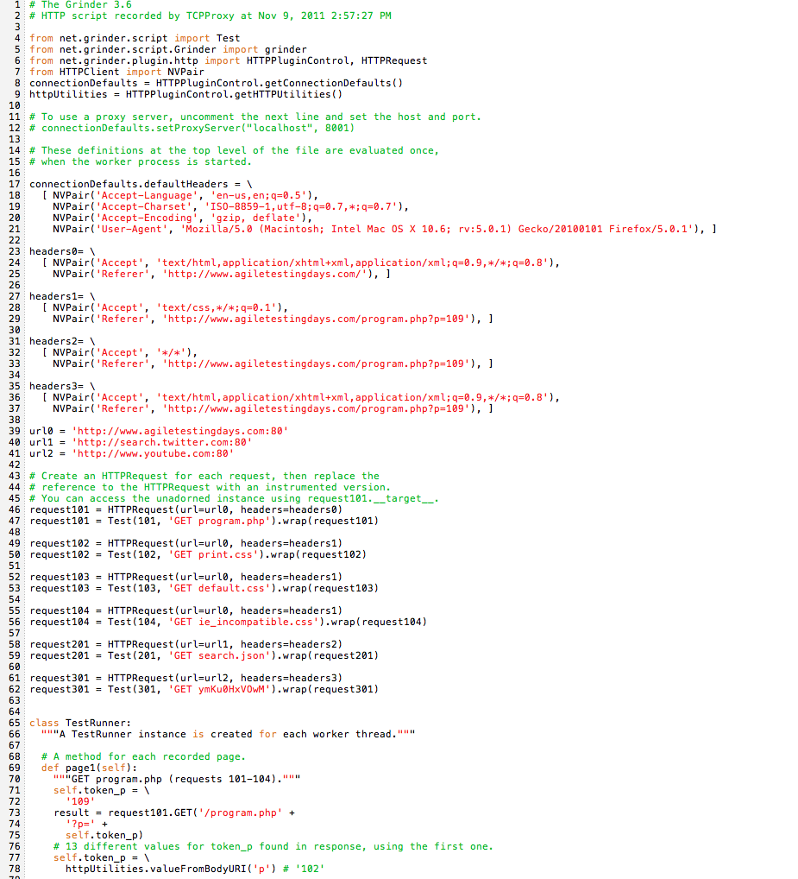

Slide 8
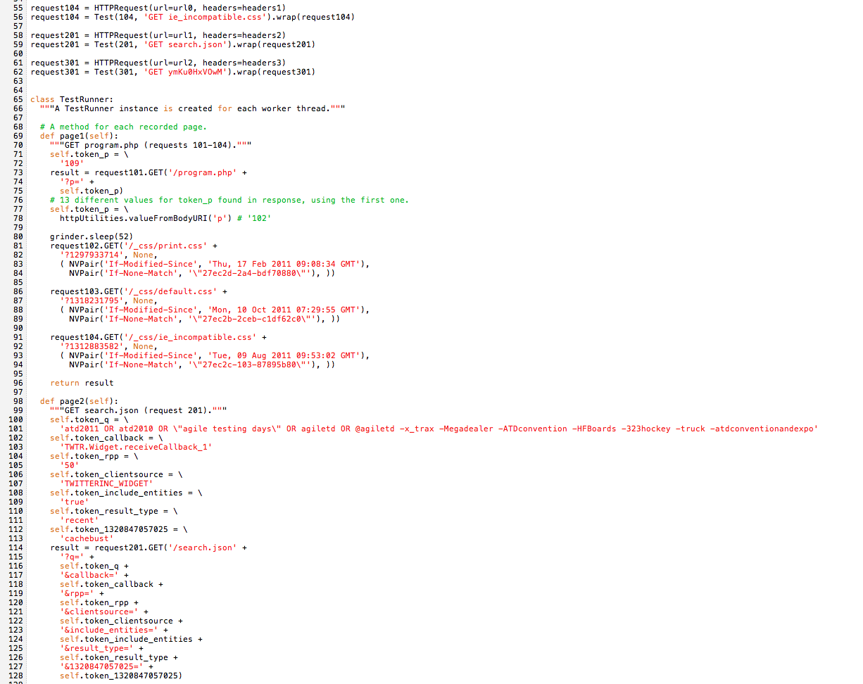

Slide 9
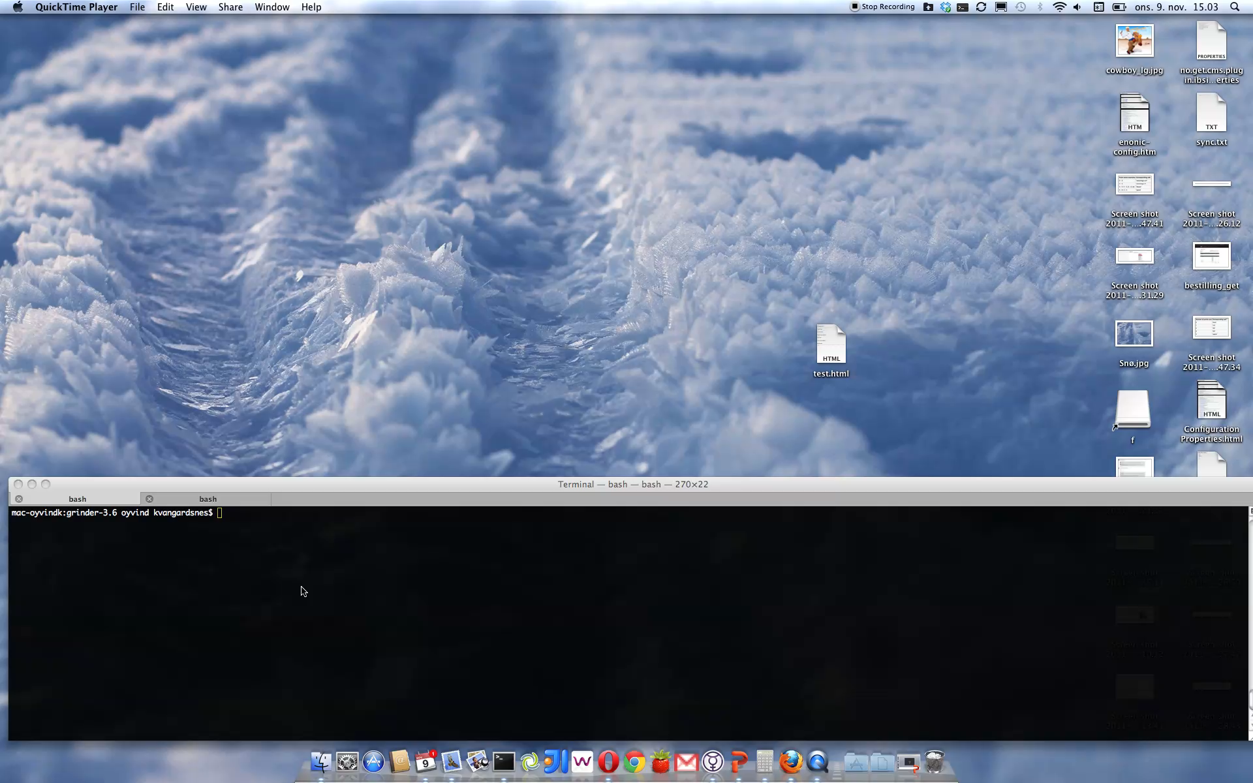
Demo: Grinder

Slide 10
Challenges with loadtesting
Expensive
Difficult to get started
Functional verification
Fragile
Maintainability
Done rarely/late/never

Slide 11
Case: JavaZoneBook

Slide 12
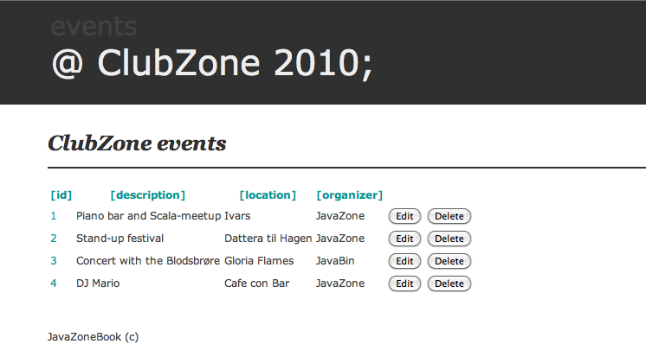

Slide 13
Webtests? WTF???

Slide 14
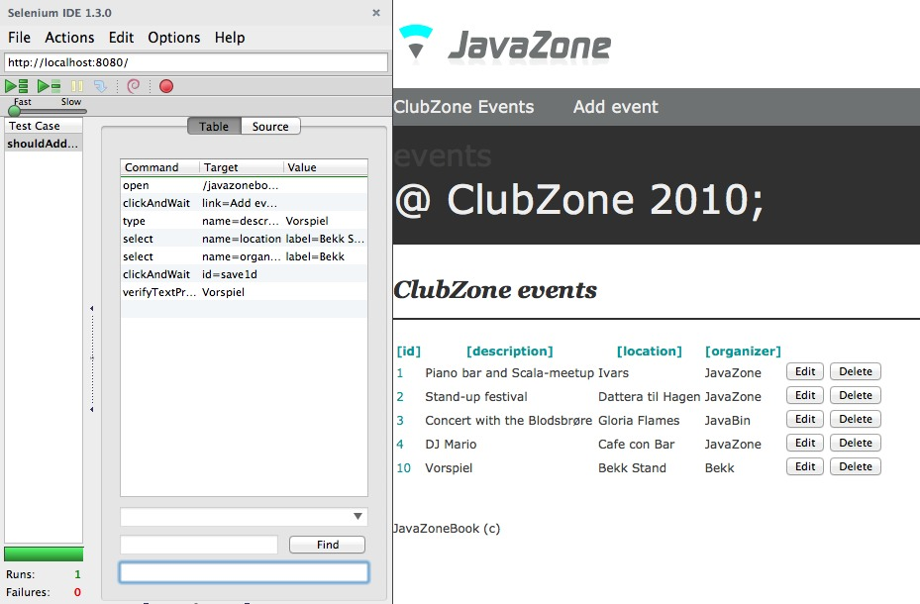
Tried it: Recorders

Slide 15

Fragile

Slide 16
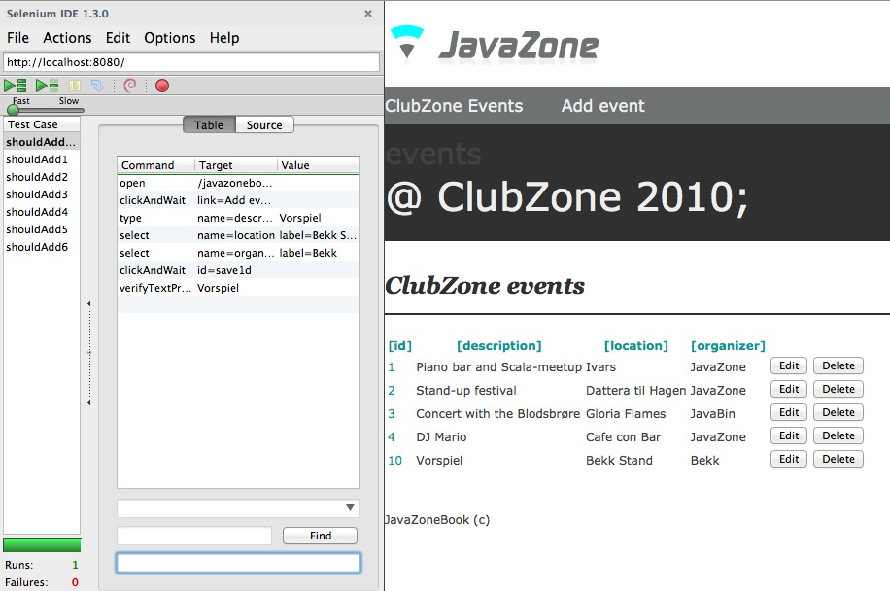
Example
!

Slide 17
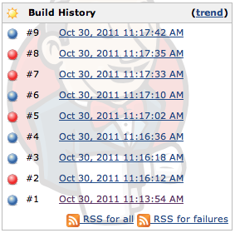
Unstable
Notes:
tester bryter uten endringer -> timing problematikk

Slide 18
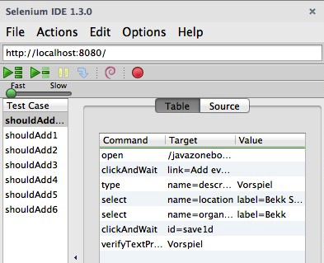
How?
Don´t record scripts

Slide 19
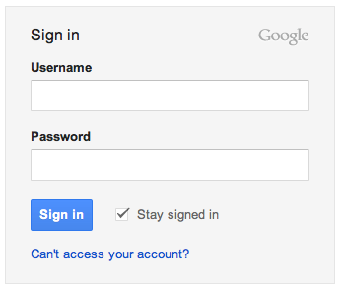
How?
Don´t record scripts
Test value chains
Don´t verify presence of
Username textfield
Notes:
verdikjeder eller kanskje til og med use cases
ta med sideobjekt figur?

Slide 20
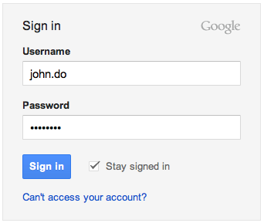
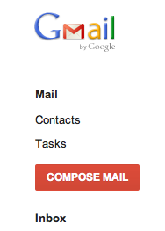
How?
Don´t record scripts
Test value chains
Verify succesful logon
Notes:
verdikjeder eller kanskje til og med use cases
ta med sideobjekt figur?

Slide 21
How?
Don´t record scripts
Test value chains
Use PageObjects
Hides implementation
details
Exposes
functionality
Test
Page
Object
Test
Test
1
1
*
*
Notes:
verdikjeder eller kanskje til og med use cases
ta med sideobjekt figur?

Slide 22
WebDriver/Selenium 2
Framework for web-interaction
Object-based API
Always interact with objects
Supports several browsers
Supports JavaScript
Stable

Slide 23
Example: WebDriver
Notes:
Lettlest kode
3 tester
Vis add test
Vis sideobjekter -> addEvent
Realtime browser-interaksjon

Slide 24
3 tests
Add
shouldAddEventToEventlist
Update
shouldUpdateEventWithLocation
Delete
shouldDeleteEvent

Slide 25
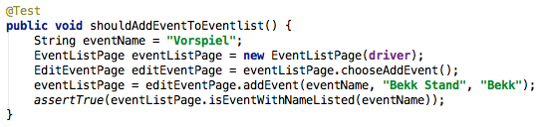

Slide 26
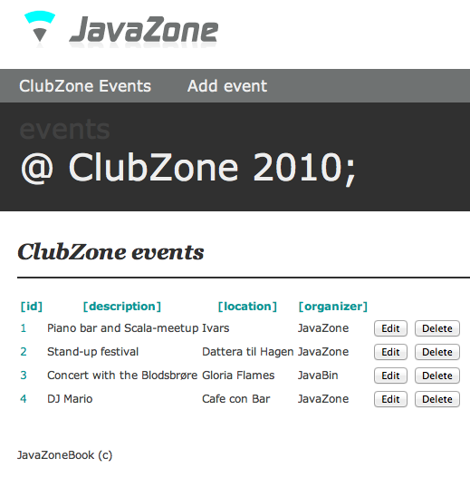

Slide 28


Slide 29
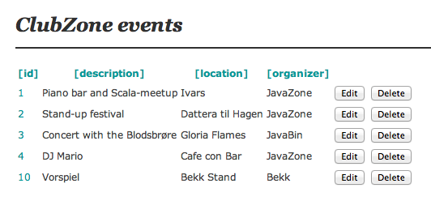

Slide 30
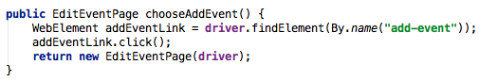

Slide 31
Run the tests!
Notes:
Lettlest kode
3 tester
Vis add test
Vis sideobjekter -> addEvent
Realtime browser-interaksjon

Slide 32
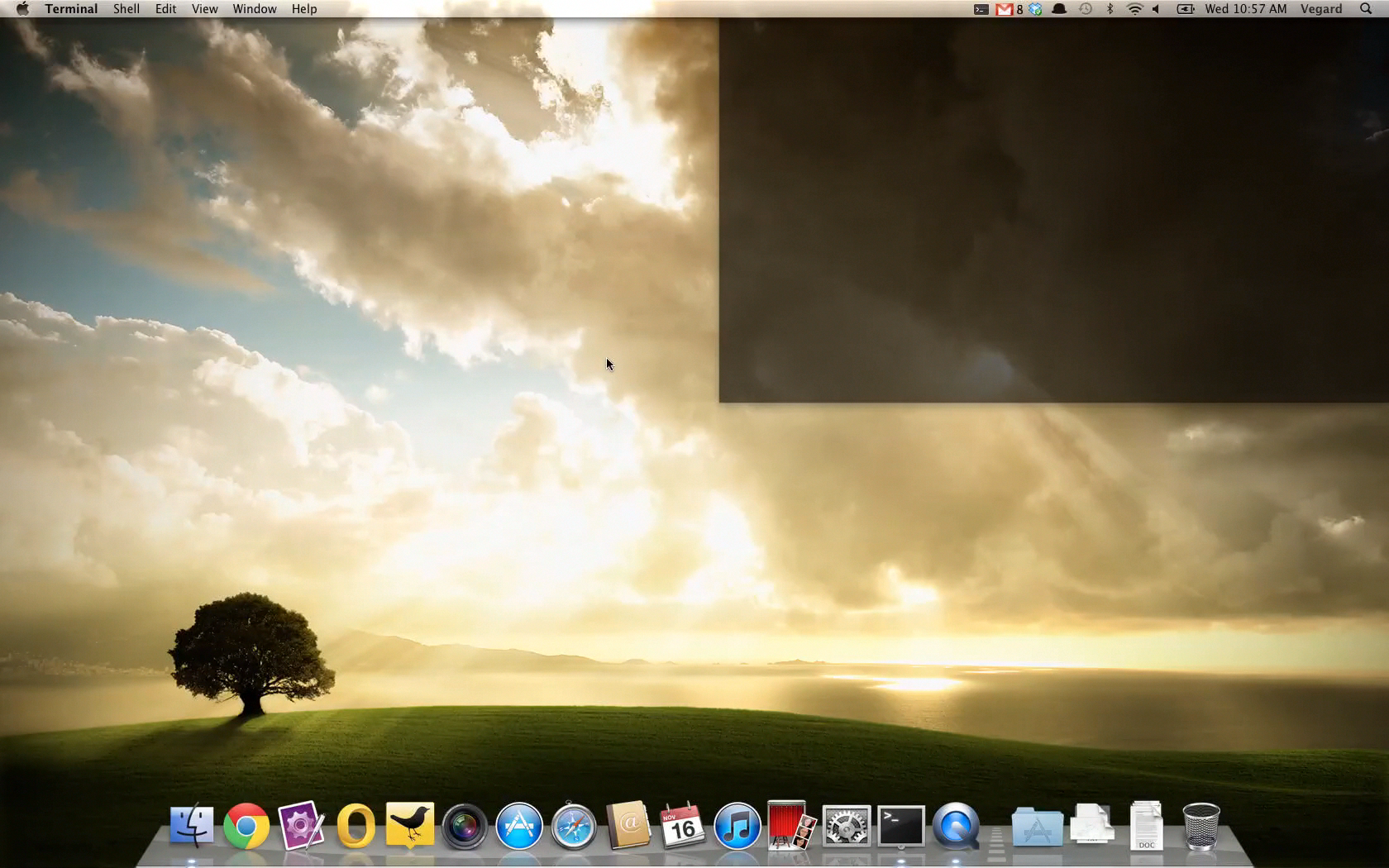

Slide 33
Challenges with loadtesting
Expensive
Difficult to get started
Functional verification
Fragile
Maintainability
Done rarely/late/never

Slide 34
Grinder + WebDriver = ???

Slide 35
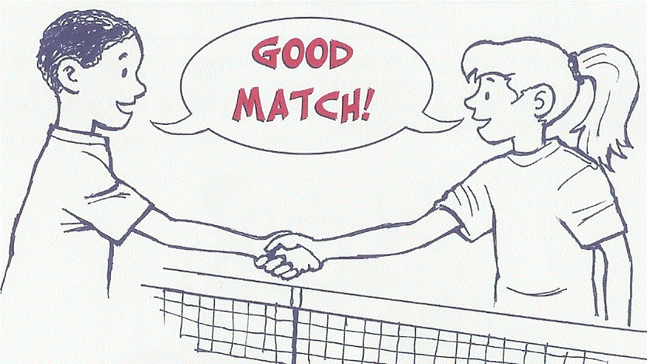
Notes:
Grinder is excellent for running loadtests
WebDriver is a great tool for advanced web testing
Both Webdriver and Grinder runs on the JVM
Can be used with exsisting tools like maven, jenkins, etc.
Can be maintained by the developers like other parts of the code base
... and can be used by testers when needed

Slide 36
The JVM

Slide 37
Tooling

Slide 38
Maintained by the developers

Slide 39
… and used by testers when needed

Slide 40
Grinder + WebDriver =

Slide 41
Demo: Grinder + WebDriver

Slide 42
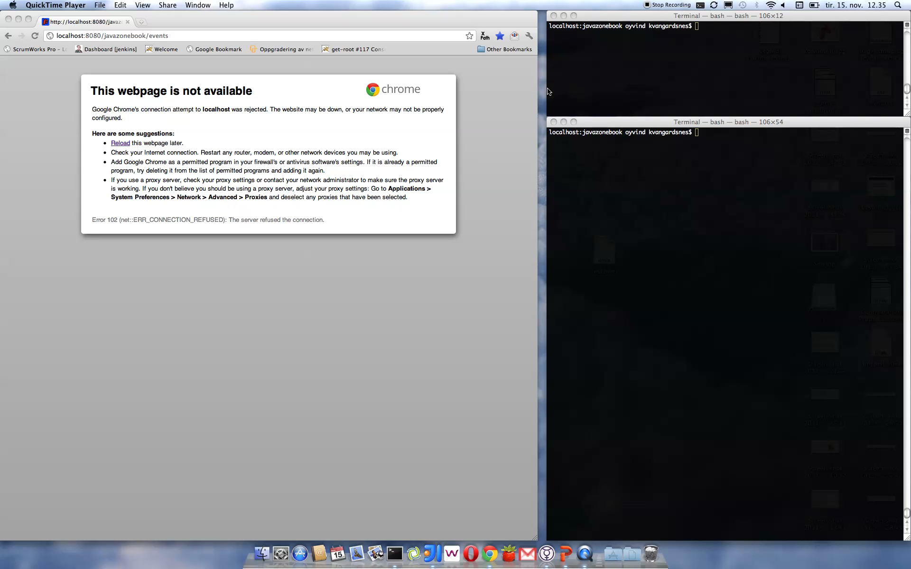

Slide 43
Challenges with loadtesting
Expensive
Difficult to get started
Functional verification
Fragile
Maintainability
Done rarely/late/never

Slide 44
Continuous loadtesting
Test application performance from commit to commit
Discover bottlenecks and load issues before they matter
Build proper response times into the application from the beginning

Slide 45
Example: Continuous load testing with Jenkins Grinder plugin
Notes:
Alle kjenner Hudson
Vis config:
mvn goal og sti til grinder fil
vis overordnet trendbilde:
gjennomsnittlig tid
standard deviation
antall tester og feil

Slide 46




Ingredients

Slide 47
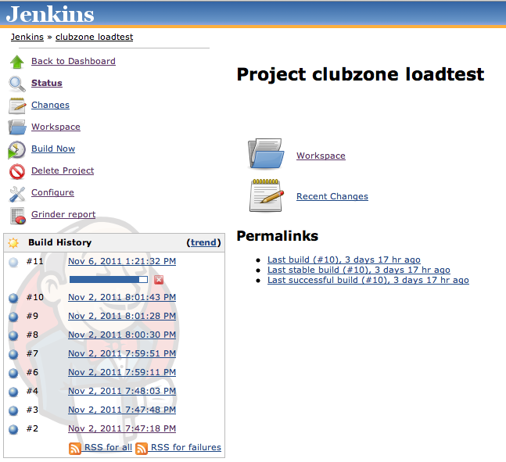
Loadtests with Jenkins

Slide 48
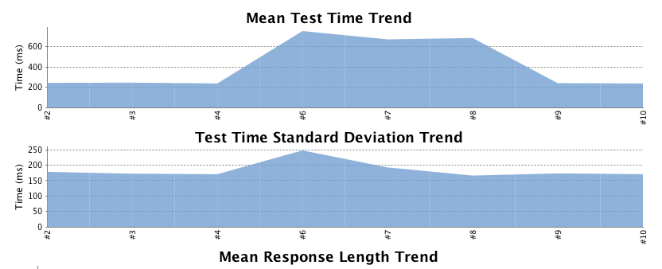
Jenkins Grinder plugin

Slide 49
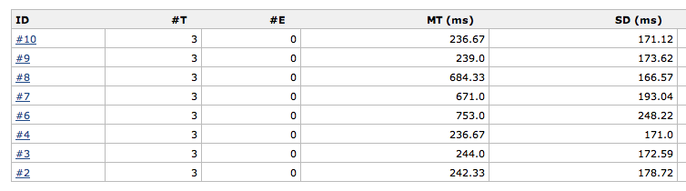
Jenkins Grinder plugin

Slide 50
Challenges with loadtesting
Expensive
Difficult to get started
Functional verification
Fragile
Maintainability
Done rarely/late/never

Slide 51
Grinder + WebDriver =
Expensive
Difficult to get started
Functional verification
Fragile
Maintainability
Done rarely/late/never

Slide 52
?

Slide 53
Vegard & Øyvind
Vegard Hartmann
@vegardhar
vegard.hartmann@gmail.com
Øyvind Kvangardsnes
@kvangaball
ok@bekk.no
https://github.com/hartmann/ClubZoneBook

